Slide 1

Being Good Digital Citizens with Today’s Technologies
Notes:
Introduce yourself and NetSafe Utah. Explain that there is a NetSafe Utah web site where you can find many of the videos that you see today and other valuable resources.
Here are some good questions to start out the presentation:
Raise your hand if you have a computer with Internet access at home?
Even if you don’t have a computer at home you probably have a friend who does, the public libraries do, and your school does.
Who likes to play games, listen to music, or watch videos on the Internet?
The Internet is a fun place to spend time, but we also need to be careful.
Just like your mom and dad follow rules when they drive a car on the road to be safe, we need to follow rules on the Internet to be safe.

Slide 2

Today’s Presentation:
Utah Statistics
Benefits & Dangers
Profile of a Teenager
Potential Risks
Cell Phones & Photos
Posting a Picture
Cyber-bullying
Personal Information
Online Friends
Talking to an Adult you Trust
Five Ways to Stay Safer Online

Slide 3
Utah Statistics
Utah ranks #1 in the nation for home computer use.
  1.8 million or 74% of Utahns have computers in their homes.
Utah ranks #5 in the nation for home Internet use.
(Huntsman, 2005)
Notes:
These statistics combined with the number of children Utah has per capita, we need to be proactive in educating parents and children on being safe online.

Slide 4
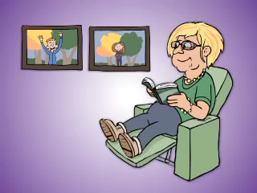
NetSafe Utah Introduction
Notes:
NetSafe Utah Overview (2 min 40 sec)
Think about the lessons we can learn from this video.

Slide 5
What do we learn from this video?
Teens get on the Internet to connect to others through…
  Social networks, instant/text messaging, games.
The Internet is like the pizza parlors and malls.
Have conversations regularly and openly.
Know what your kids are doing online like you do offline.
What else can you do?
    Have time limits.
    Install filtering and monitoring software.
Notes:
Review the points of what we learned from the video. If appropriate, ask for persons to share answers before revealing the given points.

Slide 6
What is the best Internet filter in the world?
It is free.
It is simple to use.
You take it with you wherever you go.
Notes:
Answer:
Q1: Maggie talked to her dad about her worries. Together they learned how to do searches online that help her avoid stuff that she does not want to see.
Q2: Maggie learned that Google allows you to filter out inappropriate content when you search. Maggie’s dad learned that there is filtering software that he can install to help keep inappropriate stuff out.

Slide 7

The best Internet filter is…
You
Notes:
Ask the question, “What is the best filter in the world?”
The answer is “You.” Explain that it is because you have a brain and can think. You can filter out what makes you feel uncomfortable, etc. And, you take your filter wherever you go.

Slide 8



Benefits of the Internet
Accessible from…
  Home, school, public libraries…
Communicate with…
  Family, friends, & other students.
Information for…
  Homework, news, entertainment…
Notes:
Review benefits.

Slide 9

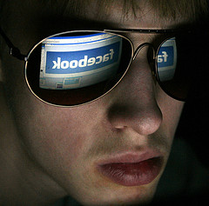
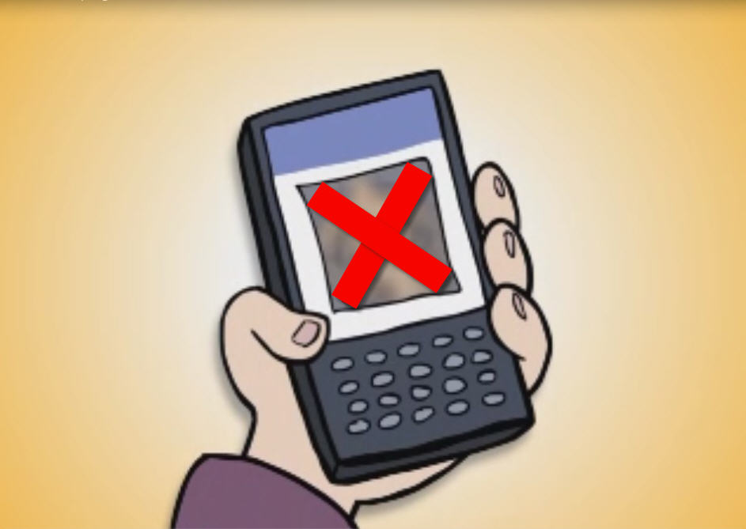
Dangers of the Internet
Accessible from…
  Virtually everywhere.
Communicate with…
  Family, friends, predators…
Information including…
  Pornography, violence, drugs…
Notes:
Interestingly, the same benefits are also the same dangers of the Internet.

Slide 10
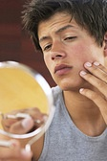
Why teenagers can be vulnerable?
Profile of a teenager
Be own person
Make own decisions
Be independent from parents
Be understood
Wants attention
Wants love
Notes:
I would like to take a moment to talk about the “Profile of a Teenager.” This helps us to understand why teens can be vulnerable to the dangers on the Internet. Teens like to be their own person….

Slide 11

Chatroom Exchange

Slide 12

Julie’s Journey
Notes:
3:00 minutes.
You can preface the video by asking parents to think about the profile of a teen.
At the end, review things that we can learn from this video.
Why would Julie run away with a 56 year old man?
How did Tom gain Julie’s trust?
How much time did Julie spend on the computer each day.
-Where was her computer located?
-Who did Julie trust more than anyone else in the world?
-Did running away solve Julie’s problems?
-Did Tom really care about Julie?

Slide 13
Potential Risks
Porn-ography | Computer Virus | Copyright Infringement | Cyber-Bullying
Online Predator | Hate Crimes | Instant Messaging | Chat Rooms
Online Gaming | Media Violence | P2P File Sharing | Popup Ads
Internet Fraud | Sexual Exploitation | Social Net-working sites | Spam
Spyware | Video Sharing | Web Blogs | Web Cam

Slide 14
How to Reduce Your Risk on the Internet
Have Anti-Virus / Spyware Software
Keep Software Updated:
  Anti-Virus / Spyware software
  Operating System - PC and Mac
  Browsers - Firefox, Internet Explorer, Safari, & others
Safe Behaviors like avoiding:
  “Free” offers
  Suspicious e-mails
  Yucky web sites
Notes:
Review bulleted items.

Slide 15
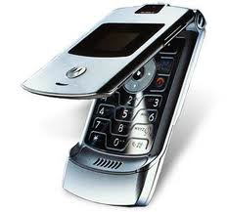
Cell Phones

Slide 16
Teens and Mobile Phones
How many teens have a cell phone (12-17 yrs old)?
  75%
What are they doing with it?
  Most texting friends daily
  One in three teens sends more than 100 texts messages a day, or 3000 texts a month.
What else?
  Take and share pictures
  Play music and games
  Access social network sites and e-mail
Pew Internet & American Life Project, Amanda Lenhart, Teens and Mobile Phones, April 20,2010
http://www.pewinternet.org/Reports/2010/Teens-and-Moile-Phones.aspx

Slide 17
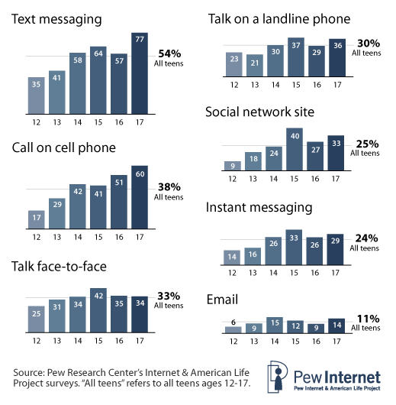
The % of teens who contact their friends daily by different methods, by age

Slide 18
Having a cell phone is a privilege, not a right.

Slide 19

Cell Phones and Photos

Slide 20
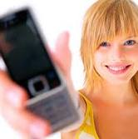
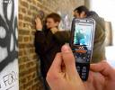
Cell Phones and Photos
Victim and perpetrator
    Often the same person
Can lead to cyber-bullying
Think before you post

Slide 21

Think before you post

Slide 22
Posting a Picture
What types of pictures should we post online?
Notes:
Introduce the concept of how posting a picture is an extension of the fact that most of today’s cell phones have cameras. You may ask, “How many of you have ever taken a picture with a cell phone?”

Slide 23

Notes:
Posting Pictures Online video (2 min 23 sec)

Slide 24
Is Maggie making a good choice here?

Slide 26
What can be some consequences for posting a picture?

Slide 28
What kinds of pictures should you post?

Slide 30
What are some other things that could happen?

Slide 32
How might these pictures effect Maggie’s future?

Slide 34
What do we learn from Maggie’s posting of pictures?
Online pictures can be forwarded and posted elsewhere.
Once a picture is posted, you can’t get it back.
Nude pictures are illegal (< 18 = child pornography).
Only post “G-rated” pictures.
Use privacy settings.
Don’t reveal personal information in pictures.
A picture you post online can effect your future.
Notes:
Answer:
Someone could copy and paste a your web site onto another web site or forward it to someone via e-mail. Once you post a picture online you can never get it back.
There are certain photos (nude pics) that should never be taken or shared – it’s illegal.
G-rated pictures are okay to post; however, a good rule of thumb is whether your grandmother would approve.
Set your privacy settings accordingly.
Keep personal information out of pictures (e.g., house numbers, school name, and phone number, e-mail address, etc.).
Potential job opportunities could be compromised.

Slide 35
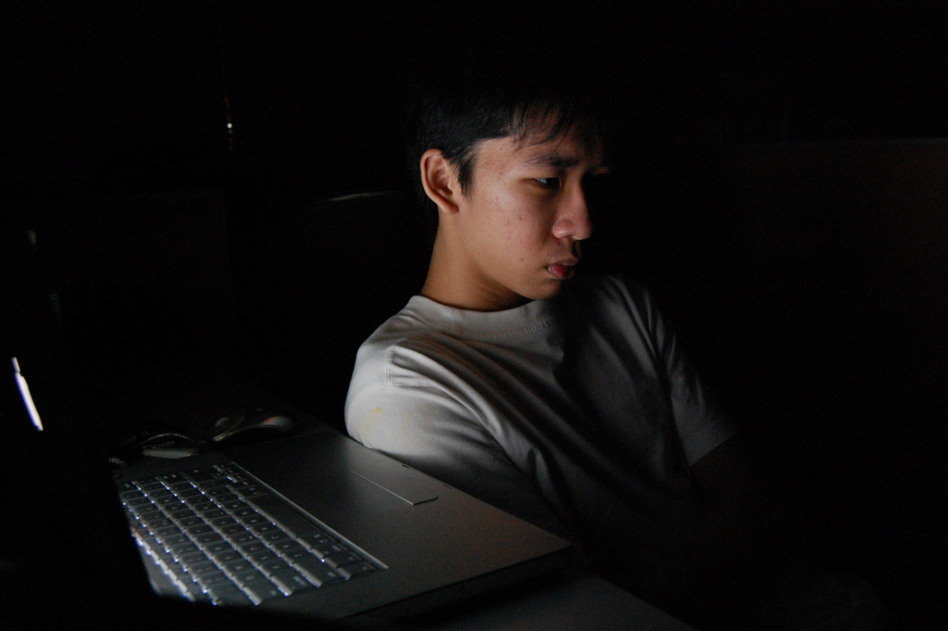
What is Cyber-bullying?
Use of technology to harass, threaten, or embarrass someone.
Courtesy of wentongg’s photostream
Notes:
Define cyber-bullying.

Slide 36

Cyber-bullying – Example
Notes:
Words Hurt. Don’t be a part of it. (60 seconds)
Produced by Concerned Children’s Advertisers (www.cca-kids.ca)

Slide 37
Cyber-bullying vs Bullying
It can happen 24/7.
It can be done from a physically distant location – easier to say hurtful things in a text message rather than face-to-face
Victims often do not know who the bully is, or why they are being targeted.
It can become viral - a large number of people can become involved.
Loss of non-verbal cues (face) and voice inflexion (joking).
Victim may become bully.
Notes:
Define cyber-bullying.
Source: http://www.cyberbullying.us/Cyberbullying_Identification_Prevention_Response_Fact_Sheet.pdf
Voice inflexion example: “I did not say I stole the money”

Slide 38
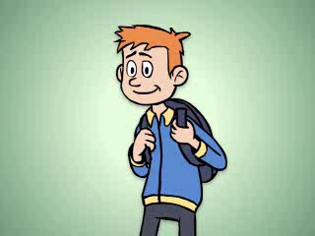

Slide 39
What does Lamer Bill do to threaten and harass Joe?

Slide 41
Wanting to skip school is a symptom of cyber-bullying.

Slide 43
Where can cyber-bullying happen?

Slide 45
What does Joe do with the threatening texts & emails?

Slide 47
What did Joe do with the “evidence”?

Slide 49
How can we stop cyber-bullying?
Do Not Respond.
Save the Evidence.
Report It.
Notes:
These steps are what you can do to stop cyber-bullying.

Slide 50
Rule of Thumb
If you won’t say it face to face, then don’t send it.
Notes:
You may want to say that it is interesting to note how teens will text things that they would never say face to face. Then, review the rule of thumb.

Slide 51
What about
Personal Information?
What can happen if…
  Someone gets your name and ssn?
  You post your e-mail address on facebook?
Notes:
Ask audience for examples of “personal information.”
Other questions that you may consider asking:
- What can someone do if they get a hold of your name and social security number?
- Should we give our best friend our password to our Facebook or e-mail account?

Slide 52
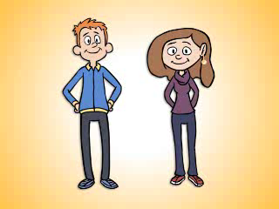
Notes:
Protect Your Personal Information video (2 min 18 sec)

Slide 53
What are some examples of personal information?

Slide 55
What can happen when someone gets Joe and Maggie’s personal information?

Slide 57
What does Joe and Maggie do to keep their personal information safe?

Slide 59
When it is okay to give out personal information?

Slide 61
Why should we keep our personal information safe?
When our personal information is safe then we are safe.

Slide 62
What can we learn about keeping our personal information safe?
Logging into a web site – a lock icon.
Don’t use obvious words for passwords.
Never give out passwords even to a best friend.
Change passwords often.
Keep security software is updated.
Be sure to log out after using a public computer.
Don’t post pictures that show personal information.
Notes:
Answer:
When Joe visits any web site that requests personal information he makes sure that there is a lock icon in his web browser. He does not use obvious words for his password (e.g., dog’s name, his nickname, his street’s name). He never gives out his password. He changes his password often. He makes sure that his security software on his home computer is up-to-date. If he ever uses a public computer, he makes sure that he is logged out when he is done.
Maggie never gives out information that would reveal where she lives (e.g., address, phone #, pictures of where she lives or where she goes to school). It’s okay to give out some personal information like your address and phone number to persons you trust.

Slide 63
Online Friends
Who should you have as your online friends?
Notes:
Introduce the notion of “online friends” and how they can be a big part of our online lives.
Ask the question, “Who should you have as your online friends?”

Slide 64
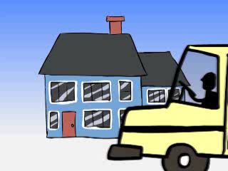
Notes:
Stick with Your Real Friends video (2 min 18 sec)

Slide 65
Should Maggie accept this “friend” request?

Slide 67
How should you decide who to be friends with online?

Slide 69
How does Maggie decide who her friends are?

Slide 71
What did Maggie learn about being safe online?
Don’t accept “friends” that you don’t know in real life.
Use privacy settings.
Notes:
Answer:
Maggie declines to accept a person she does not know as a “friend” on her Facebook account.
If you are friends with someone in the real world, it’s okay to be friends with them online. This rule goes for all kinds of web sites, chat rooms, e-mail, text messaging, and instant messaging.
Set your privacy settings accordingly.

Slide 72
Talking to an Adult You Trust
So, who is an adult you know that you trust?
Notes:
Introduce the concept of how things may happen on the Internet may cause you to feel uncomfortable. When this happens you can always talk to an adult you trust.
Ask the question, “So, who is an adult you know that you trust?”

Slide 73

Notes:
Trusted Adults Can Help You video (2 min. 20 sec)

Slide 74
What are the things that Maggie really doesn’t want to see online?

Slide 76
Who does Maggie talk to?

Slide 78
What do Maggie and her Dad do to be safe?

Slide 80
What else can happen online?

Slide 82
So, what can you do if you see something online that makes you feel uncomfortable?

Slide 84
Who are the people that are there for you?

Slide 86
What did Maggie (and her Dad) do to be safer on the Internet?
Use of the Google filter.
Installed a software filtering system to block unwanted content.
Agreed on G and PG content.
Told a person she trusted when something made her feel uncomfortable.
Notes:
Answer:
Q1: Maggie talked to her dad about her worries. Together they learned how to do searches online that help her avoid stuff that she does not want to see.
Q2: Maggie learned that Google allows you to filter out inappropriate content when you search. Maggie’s dad learned that there is filtering software that he can install to help keep inappropriate stuff out.

Slide 87
Five Ways to Stay Safe Online
Talk about it.
Implement Safety Tools.
Avoid Isolation.
Guard Personal Information.
Don’t respond, save the evidence, and report it.
Notes:
Refer to handout “Five Ways to Stay Safe Online.”
Review each step.

Slide 88
What have we learned about today?
Utah Statistics
Benefits & Dangers
Profile of a Teenager
Potential Risks
Cell Phones & Photos
Posting a Picture
Cyber-bullying
Personal Information
Online Friends
Talking to an Adult you Trust
Five Ways to Stay Safer Online

Slide 89
To learn more, go to:
Notes:
Explain again that the NetSafe Utah web site is where you can find many of the videos that you saw today and other valuable resources.
The end.

Slide 90
Questions?

